Slide 1
VSEPR THEORY
VALENCE SHELL ELECTRON PAIR REPULSION THEORY

Slide 2
VSEPR THEORY

Slide 5
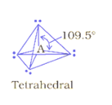
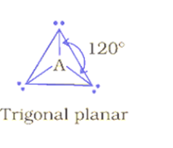
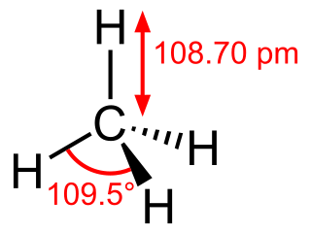
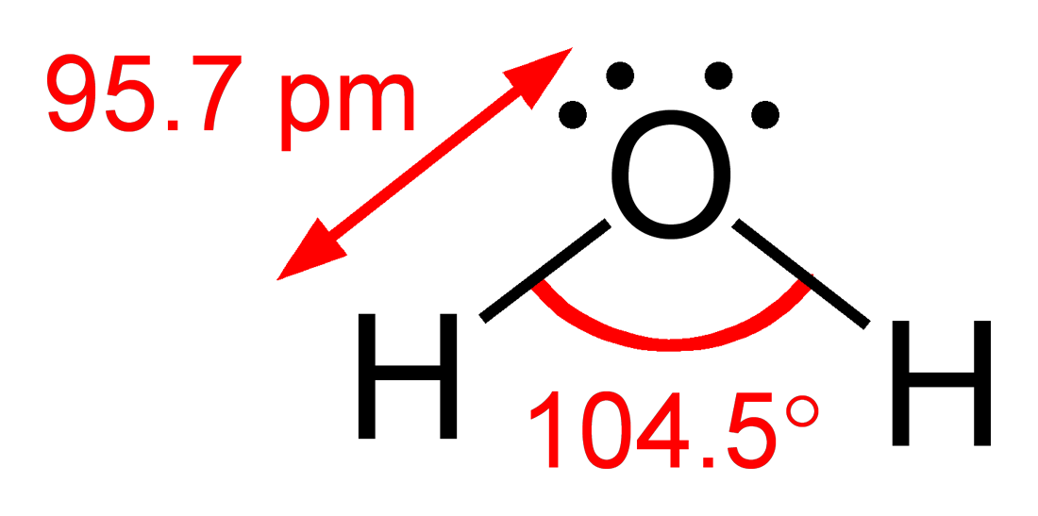

Slide 6
